Slide 1
IETF Hackathon
IETF 108
July 20-24, 2020
Online
IPWAVE Basic Protocols Project Champion: Jaehoon Paul Jeong pauljeong@skku.edu
Sungkyunkwan University

Slide 2
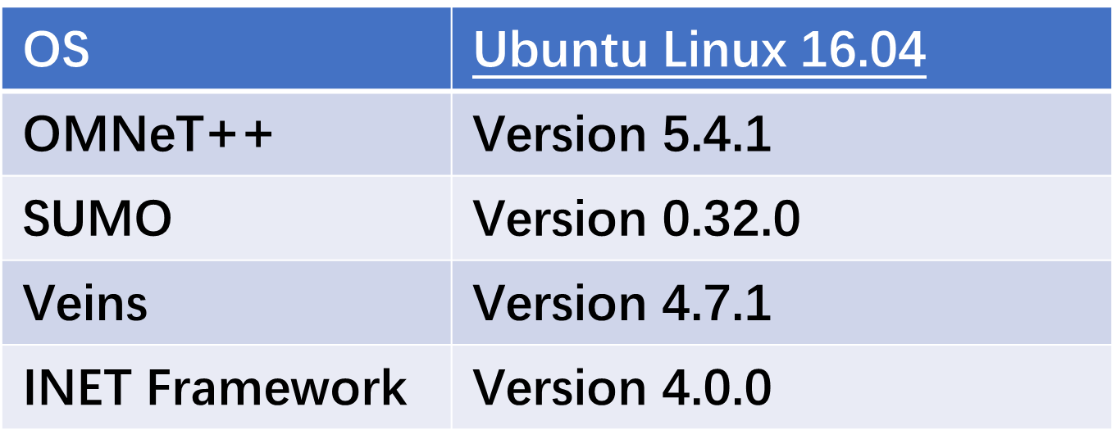
Hackathon Plan
Provide a Context-Aware Navigator Protocol (CNP) for IP Based Vehicular Networks:
Proof of Concept (POC) of IPv6-Based Context-Aware Navigator Protocol
IPv6 mobility information sharing for safe driving in roadways
Coordinated path planning for obstacle and collision avoidance in roadways
Efficient driving information exchange in IP-based vehicular networks
Network-based coordinated driving environment sensing and perception
Proving strategy:
Vehicular Simulations of IPWAVE with OMNeT++, SUMO, and VEINS

Slide 3
Context Awareness in IP-Based Vehicular Networks
CCM
Context Awareness in IP based Network
Via lightweight messages Cooperative Context Messages (CCM)
Emergency Context Message (ECM)
ECM

Slide 4
Vehicle Mobility Information
VMI options:
Type: Either: CCM and ECM
0
1
2
3
0
1
2
3
4
5
6
7
8
9
0
1
2
3
4
5
6
7
8
9
0
1
2
3
4
5
6
7
8
9
0
1
Type | Length | Message | Reserved 1
Reserved 2
Mobility Information

Slide 5
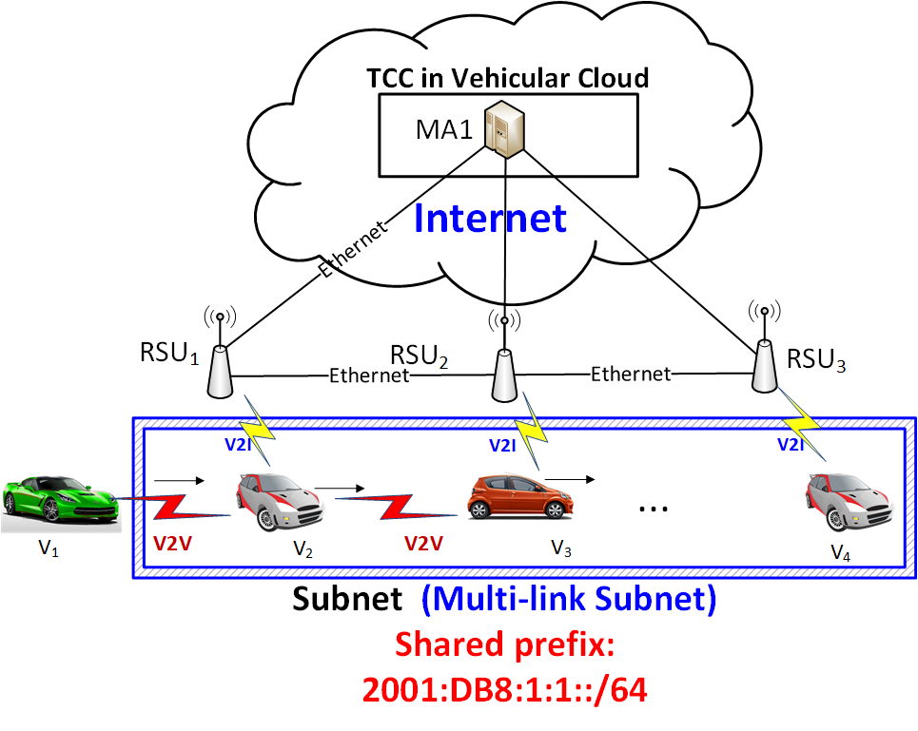
Simulation Network Structure (1/2)

Slide 6
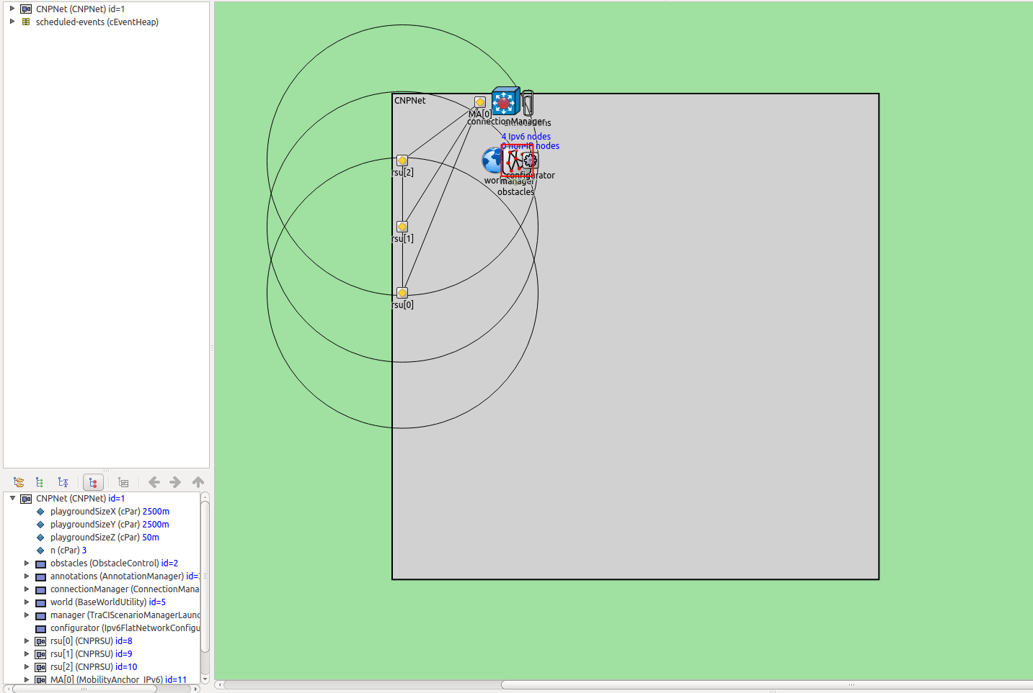
Simulation Network Structure (2/2)
Two RSUs :
Belong to one subnet.
Connect with each other through Ethernet.
ffMultiple Vehicles :
Driving through the road segment
Mobility Anchor:
Manage RSUs and Vehicles.

Slide 7
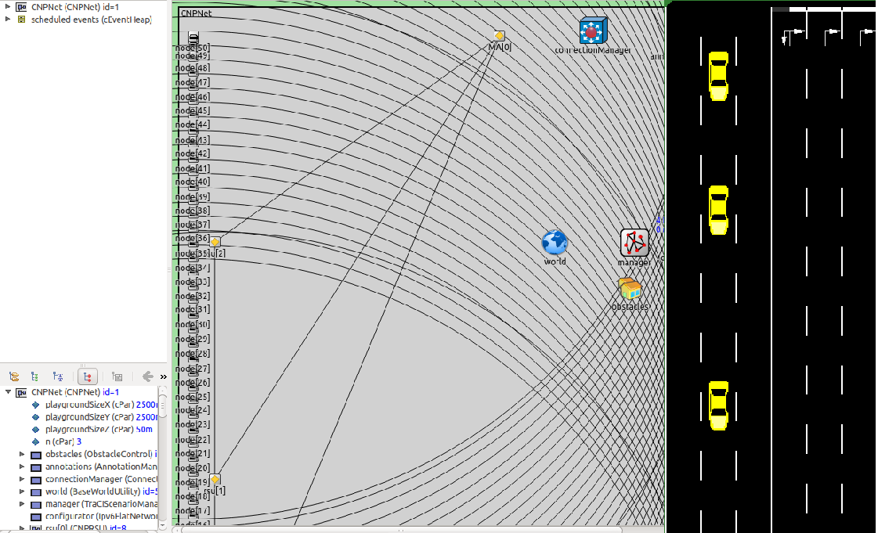
What got done
Setting up successfully a network with 3 RSUs
Mobility Information Exchange among vehicles
Coordinated maneuver when obstacle is detected

Slide 8
What we learned
Lessons learned from this hackathon:
To be able to exchange vehicle mobility over IP require an extensive modification of INET packets
A coordinated algorithm orchestrates vehicles maneuvers to enhance road safety when obstacles are detected

Slide 9
Wrap Up
Team members:
Champion:
Jaehoon Paul Jeong (SKKU)
Students:
Younghan Kim (SSU)
Bien Aime Mugabarigira (SKKU)
Yiwen Chris Shen (SKKU)
Ahn Yoseop (SKKU)
Kyoungjae Sun (SSU)
First timers @ IETF/Hackathon:
Niket Agrawal (TU Delft)
Kyungsik Kim (KNU)
Park Jinho (KNU)
Video clip demo:
https://www.youtube.com/watch?v=6Ss5OzV88so
Where to get code (manual):
https://github.com/ipwave-hackathon-ietf/ipwave-hackathon-ietf-108

